Slide 1
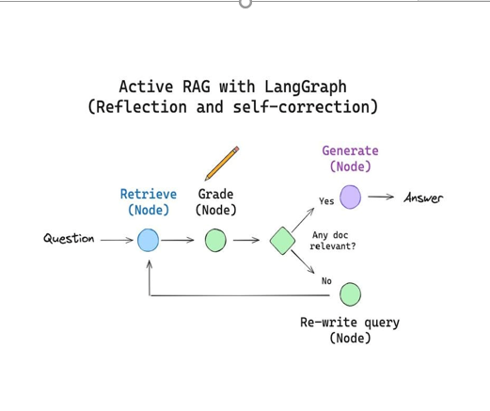
LangGraph Fundementals
AI Season Bootcamp – Session 7
- An open-source teaching repo at the boundary of LLM application design and production engineering.
- github.com/MuhammadMustafa18/WhatsAppLangraphAgent
Muhammad Mustafa
Instructor at AI Season
AISEASON
AI SEASON • DAY 1

Slide 2


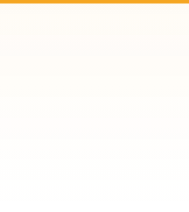
Session Agenda
01 / Foundation
Iterations 1–3
Iteration 4
Iteration 5
Iteration 6
What is LangGraph?
Why state machines for
LLM apps?
Echo graph → LLM call → conditional routing
Per-persona system prompts
Slash-prefix dispatch
SqliteSaver checkpointer
thread_id = chat_id
Iter 6 streaming · Iter 7 HITL · Iter 8 multi-agent
Then: the production refactor (Phase 1–35)
AI SEASON • AGENDA
AISEASON

Slide 3
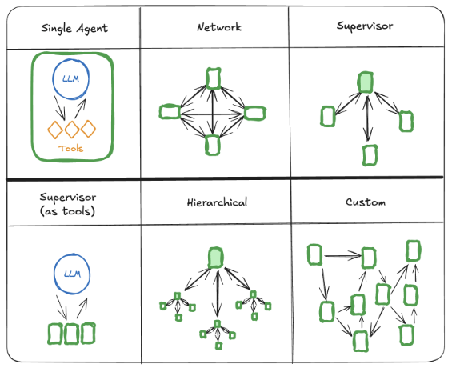
What is LangGraph?
A graph runtime for stateful LLM applications
LangGraph is focused on the underlying capabilities important for agent orchestration:durable execution, streaming, human-in-the-loop, and more.
AI SEASON • Langgraph FOUNDATIONS
AISEASON

Slide 4
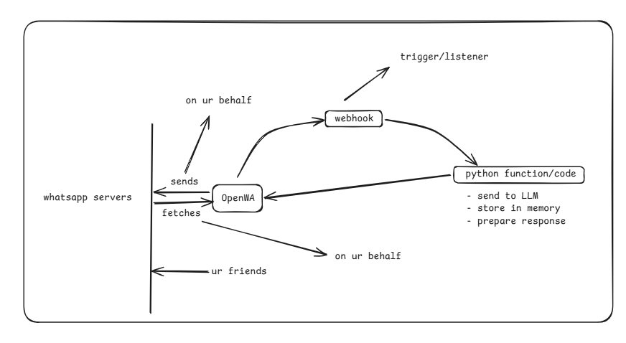
Project Specifics
Whatsapp Gateway - OpenWA
OpenWA is a free, open-source WhatsApp API Gateway designed for developers who need full control over their messaging infrastructure—without vendor lock-in or hidden paywalls.
https://github.com/rmyndharis/OpenWA
Whatsapp Gateway
AISEASON

Slide 5
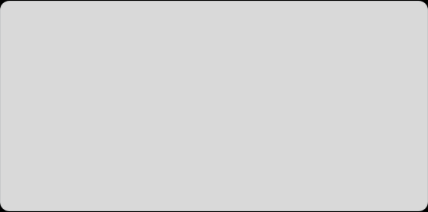

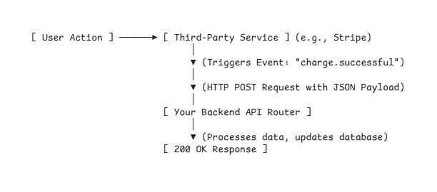
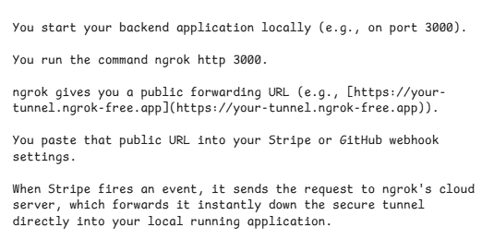
NGROK AND WEBHOOKS
What are Webhooks?
What is Ngrok?
In simple terms, a webhook is an automated notification sent from one application to another when something specific happens.
ngrok is a developer tool that creates a secure, temporary tunnel from the public internet straight to a port running on your local machine.
AI SEASON • NGROK AND WEBHOOKS
AISEASON

Slide 6
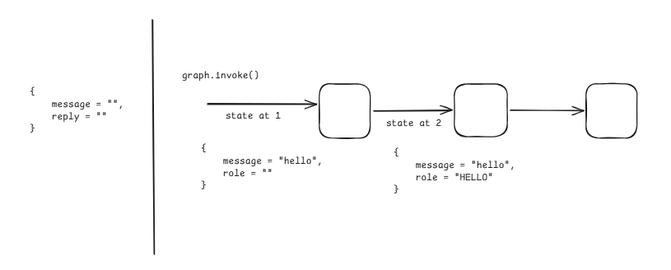
Iter 1: Echo Graph
Prove the runtime before the LLM is in the loop
A LangGraph that takes a message in and returns the same message out, driven by an OpenWA webhook — proving the entire runtime (graph construction, OpenWA
→ FastAPI → LangGraph → OpenWA loop) works end-to-end before any LLM is in the picture.
AI SEASON • Iter 1: Echo Graph
AISEASON

Slide 7

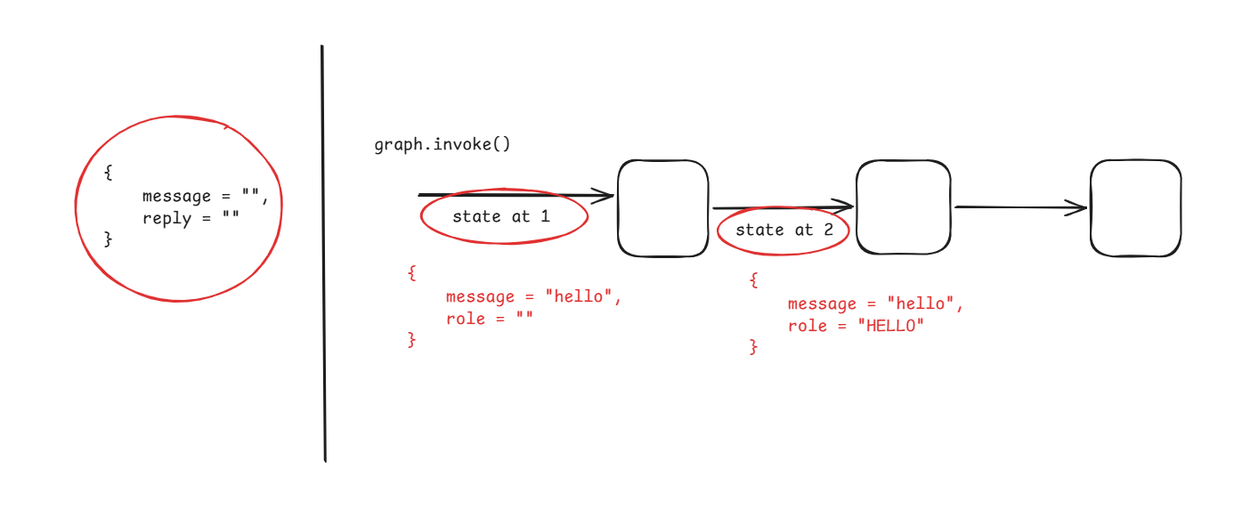
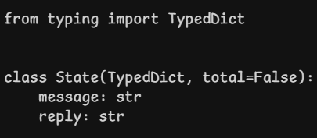
State in LangGraph
State is the one dictionary that every node in your graph reads from and writes to. There is nothing else shared between nodes — no globals, no request
objects, no service containers. If two nodes need to coordinate, they coordinate through state.
AI SEASON • State in LangGraph
AISEASON

Slide 8
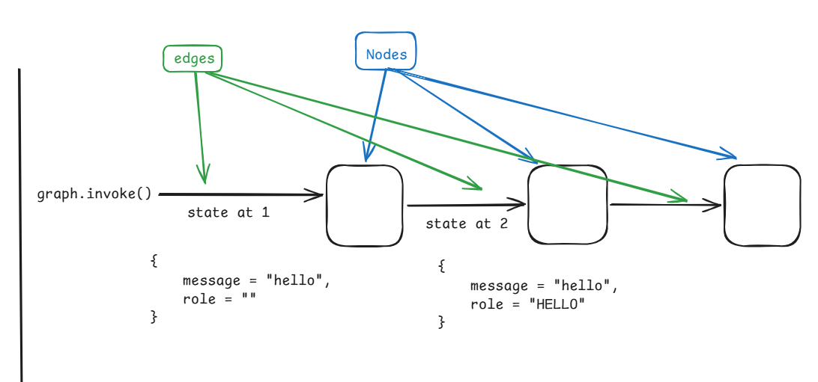
Nodes and Edges
A node is just an async Python function: it takes the state, does some work, returns a partial update. That's the entire definition.
An edge is the arrow that says which node runs after the current one. There are two kinds: static (always goes one place) and conditional (decides at
runtime based on state)
AI SEASON • Nodes and Edges
AISEASON

Slide 9
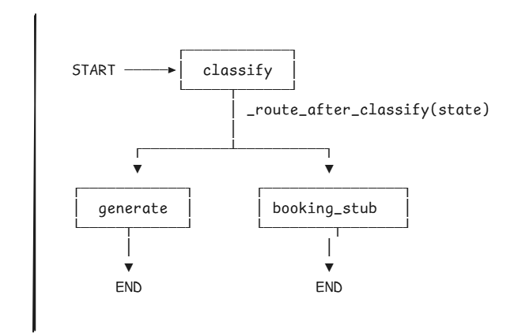
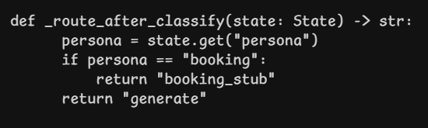
Conditional edges
A routing function that takes state and returns the name of the next node.
AI SEASON • Conditional edges
AISEASON

Slide 10
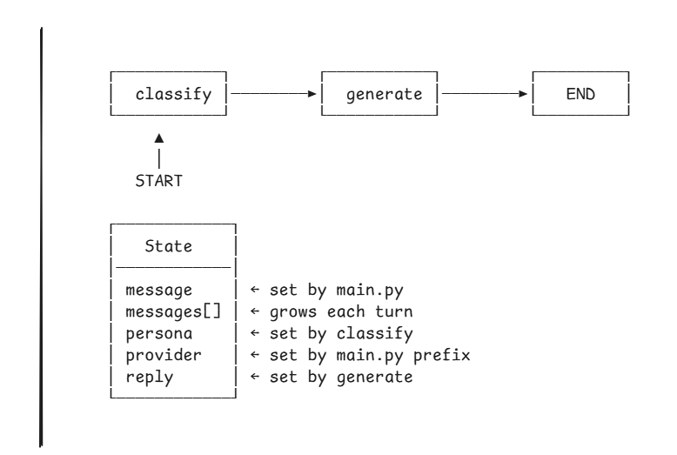
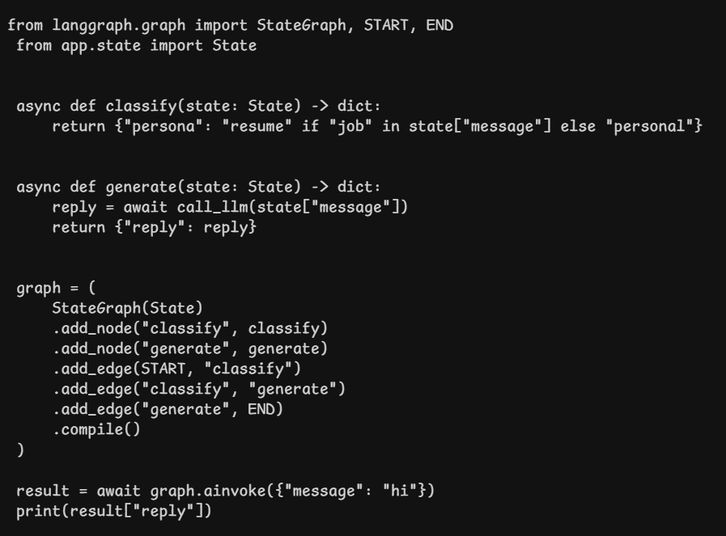
Building a Graph — A Worked Example
AISEASON

Slide 11
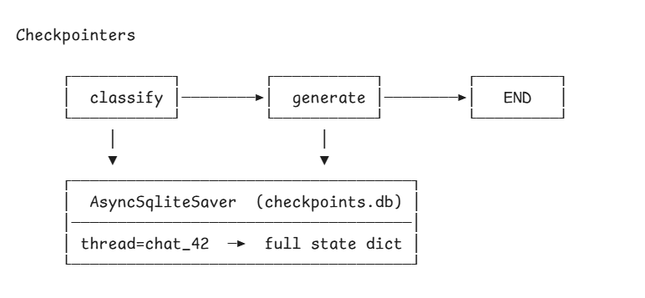
Checkpointers
A checkpointer persists the full state dict to disk after every node runs. The next ainvoke for the same thread_id loads it first. You turn a stateless graph into a stateful one with one extra argument — compile(checkpointer=saver). In this repo it's AsyncSqliteSaver, one SQLite file, thread_id = chat_id.
State becomes durable for free. No session table, no cache, no expiry logic — the runtime handles it.
AI SEASON • Checkpointers
AISEASON

Slide 12
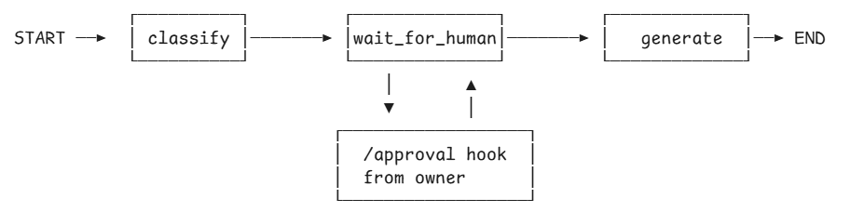
Human-in-the-Loop (HITL)
A node parks the graph and returns. A webhook later resumes it by calling ainvoke with the same thread_id plus the human's decision in state. The graph itself never knows time passed — it's the runtime that waits.
AI SEASON • HITL
AISEASON

Slide 13
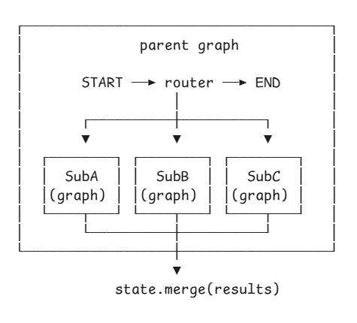
Subgraphs
- A subgraph is a compiled LangGraph that runs as a node. The parent treats it like any other node function give it state, get back a partial dict. Internally the subgraph runs its own classify → generate → END against its own state.
- Useful for multi-agent patterns: parent graph routes, subgraphs do the work, parent merges. Same runtime, smaller graph, separate concerns. Same thread_id flows through both.
- The parent's router picks which subgraph. The merge step aggregates their returns. Subgraphs don't know about each other — they just see state in, return dict out. Same contract as a node, one level deeper.
AI SEASON • Subgraphs
AISEASON

Slide 14
Innovation Begins with Curiosity
"AI will not replace humans. But humans using AI will replace humans not using AI."
Open Q&A Session
aiseason.tech
AI SEASON • CONCLUSION
AISEASON

